Slide 1
RBA RDC Status
March 16, 2015

Slide 2
Automation Integration
Team
Onsite
Scrum Master / BA – Krishna M
Dev Center
Angular JS / C#, .NET – Sekar C
Python Developer – Sachin D
Python Developer – Nitin V
Python Developer – Bhavani S R
QE – Bhawani S
Overall Health for current period
Resourcing Status
Delivery and Transition Status
RDC Current Projects RDC Future Projects
NIS UI – Device Maintenance
NIS API Enhancements
SAM Refactoring
Newton UI – API Enhancements
Script Management and Replication
BPI – LBS
Monitoring Services
AI – QE/Testing Enhancements
NIS UI - Reporting
Accomplishments / Deliverables:
NIS UI
Demoed to Product Owners and Management.
Appreciated and well received by the Users.
UAT in Progress.
Knowledge Sharing
Completed.
Dev team has sent the KT documentation for review.
NIS API
Continuous requests from Users.
Prod deployed and used by the Newton Users.
Sprint Progress
Completed and reviewed Sprint 85, 86, 87, 88, 89, 90 , 91.
Sprint 92 – In progress
Project Metrics: Completed Story Points – 110; Backlogs Story Points – 45; Sprint Velocity – 20 pts / Sprint.

Slide 3
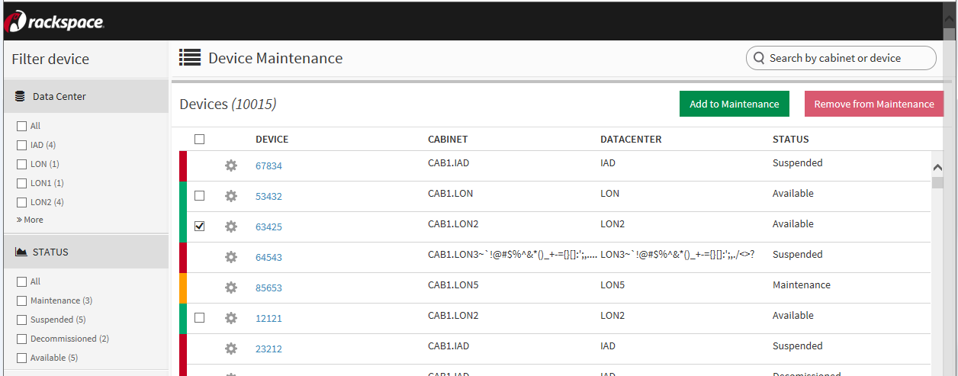
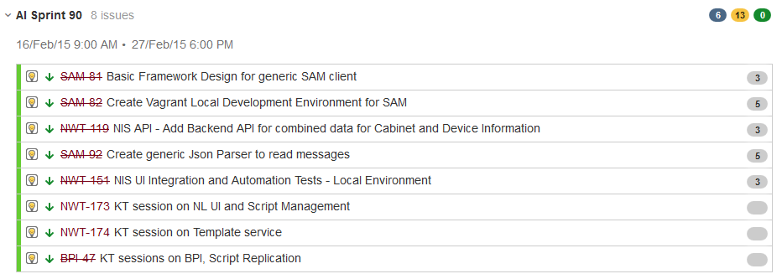
Automation Integration – Attachment 1
Automation Integration – NIS UI
Automation Integration - RDC Sprint 90 Backlogs
Jan’15

Slide 4
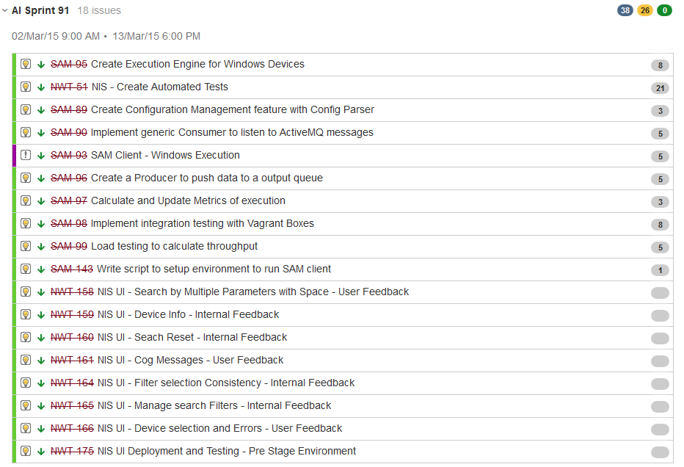
Automation Integration – Attachment 2
Automation Integration – RDC Sprint 91 Backlogs
Jan’15

Slide 5
NGAF
Team
Onsite
Scrum Master / BA – Ashish Jain
Dev Lead – Chandra (On boarded in March
Dev Center
Angular JS – Rasmi M
.NET Developer – Natraj M
Overall Health for current period
Resourcing Status
Delivery and Transition Status
RDC Current Projects RDC Future Projects
Events API changes - Nancy migration, Expose light weight calls
Failed Events UI
Light weight Event Viewer
Next Gen Ops Panel
Dashboard for in-flight events - Pie charts and Trend chart to show events count by various criteria
Allows Ops team to pause events for Ops review and then kill / resume
Accomplishments / Deliverables:
Ops Panel Development
On schedule. 80% original scope completed.
Feedback from demos completed
Issues related to trend chart being worked on.
UI Testing - Manual testing in absence of QE
API Testing - Automated Integration test process using ARIC
Sprint Progress
Completed Sprint 85, 86, 87, 88, 89, 90 , 91. Sprint 92 – In progress
Jan’15
Project Metrics: Completed Story Points – 120; Backlogs Story Points – 30; Sprint Velocity – 20 pts / Sprint.

Slide 6
Automation Integration – Attachment 2
Automation Integration – RDC Sprint 91 Backlogs
Jan’15

Slide 7
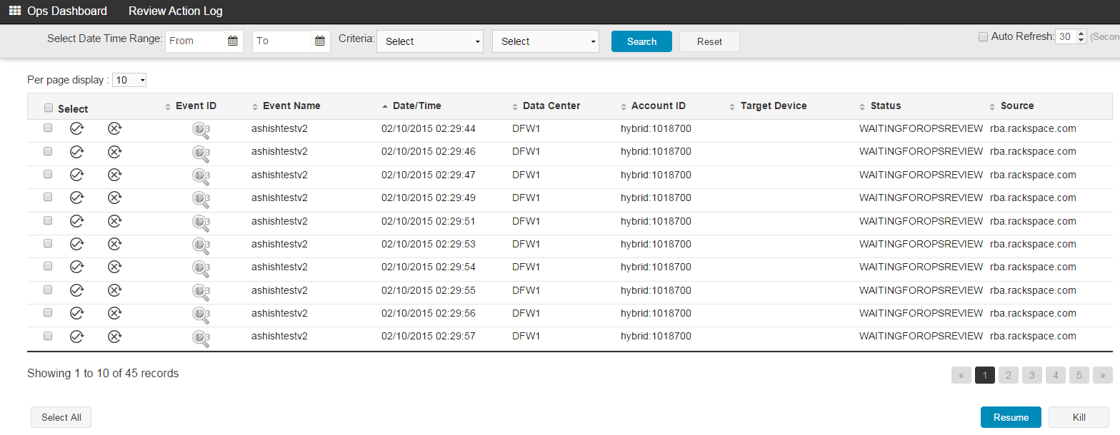
NGAF – Attachment 2
Next Gen Ops Panel
Jan’15

Slide 8
ARIC
Team
Onsite
Scrum Master / BA – Mrigank
Lead Dev - Gomes
Dev Center
2 Angular JS Developers
2 .NET Developers
Overall Health for current period
Resourcing Status
Delivery and Transition Status
RDC Current Projects RDC Future Projects
Rackspace AutoCall Group Management
Process Quick Link
Process List Page
Enhancements/Bug-Fixes
Menu Integration
UI Standardization
Nested Actions
Enhancements/Bug-Fixes
Accomplishments / Deliverables:
Team:
BA/SM, Onsite Lead, 1 .Net Dev, 1 buffer .Net Dev, 2 Angular JS Dev staffed. One QE identified. 1 Angular JS and 1 QE to be inducted
Architecture and Codebase
Process Quick Link, Defect Fixes, Enhancements
Sprint Progress:
Sprint 1 3/2 – 3/13 21 points QE approved.
Demo
Demo Planned for 3/30

Slide 9
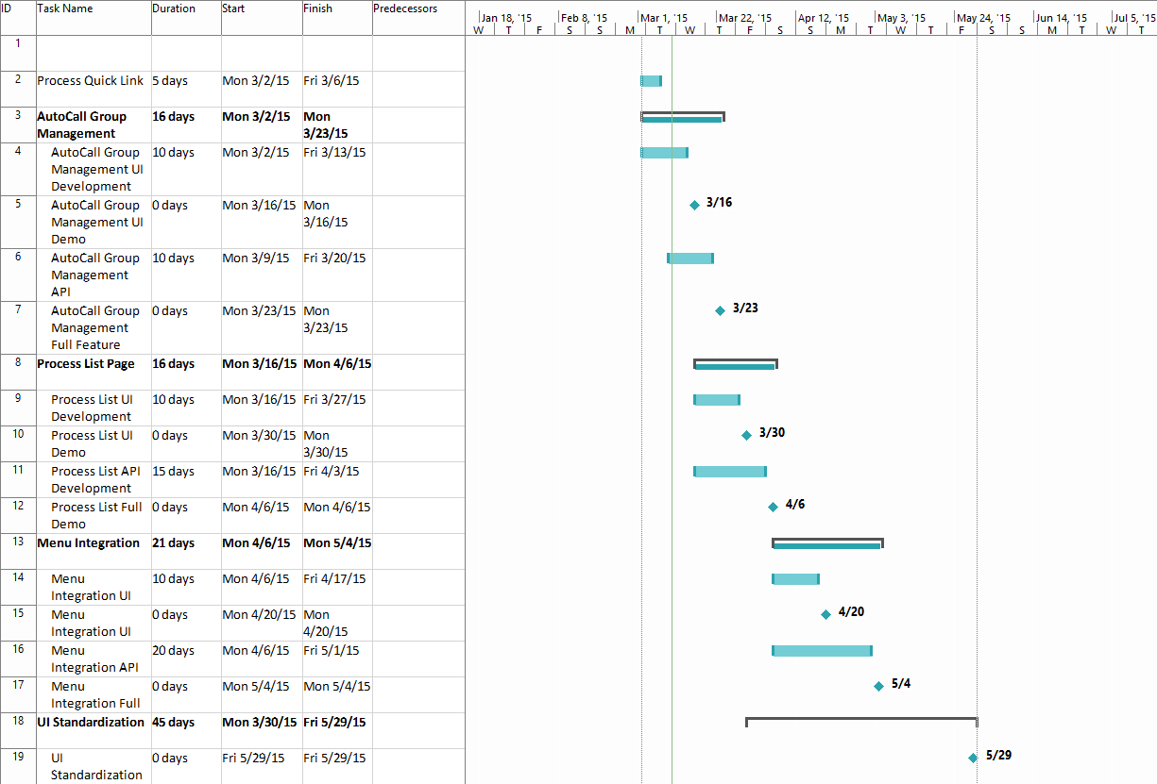
ARIC Roadmap
March
AutoCall Group Management Demo (3/30)
April
Process List Full Implementation Dev Done (4/6)
Menu integration UI Demo (4/20)
May
Menu Integration Feature Demo (5/4)
UI Standardization Demo (5/29)
Process List UI Dev Done (3/30)
Bug Fixes/Enhancements
Bug Fixes/Enhancements
Transition Complete 5/31
Process List Demo (4/13)
AutoCall Group Management Dev Done (3/23)
Jan’15

Slide 10
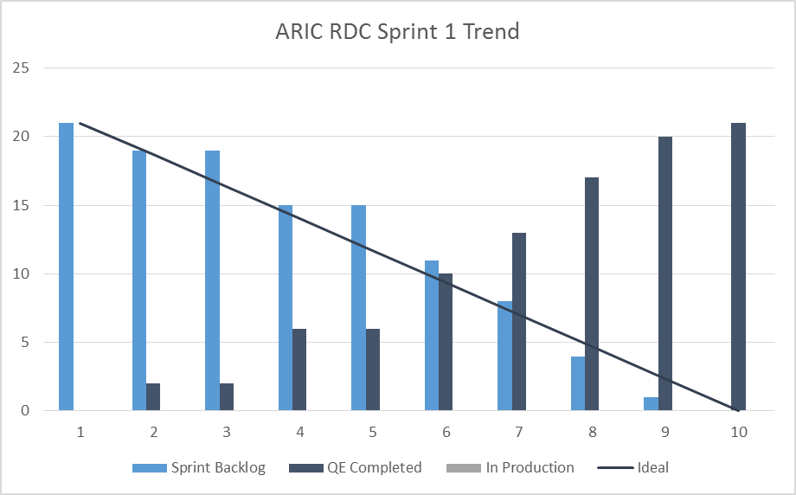
Aric – Attachment 1
Jan’15

Slide 11
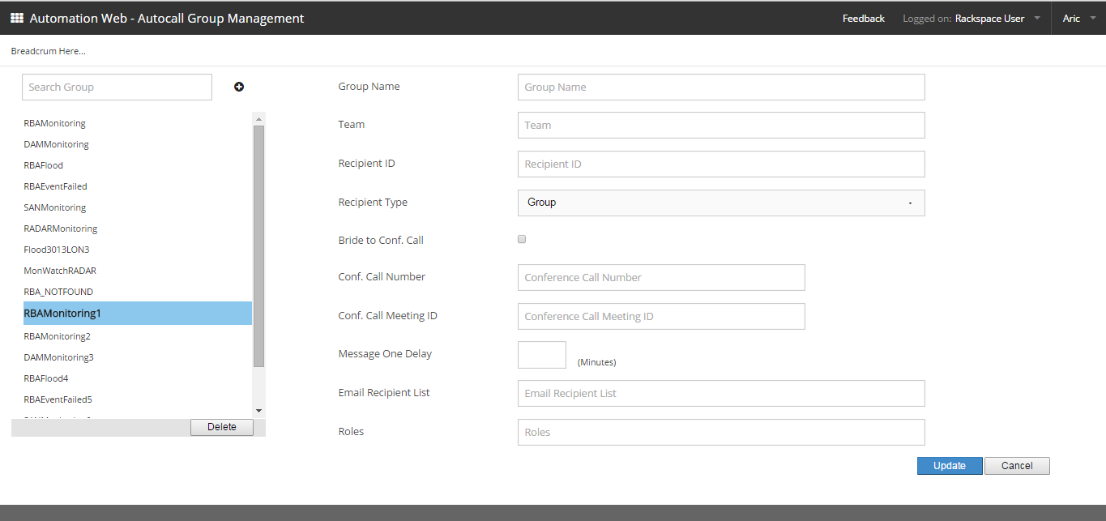
Aric – Attachment 2
AutoCall Group Management
Jan’15

